Slide 1
Data Science
is Software
PETER BULL
@drivendataorg / @pjbull
Notes:
About me
About DrivenData
About this talk

Slide 2
“It's easy to enhance a FORTRAN compiler to compile COBOL as well; it's just a SMOP.”
— SMOP entry in The Jargon File
(a comprehensive
compendium of
hacker slang)

Slide 3
Notes:
Steve McConnell, Code Complete: A Practical Handbook of Software Construction, Second Edition
- Lots of good reasons for these, but I want to frame this as an exercise in empathy. Most best practices exist for two reasons:
> Anyone you may collaborate with
> Future you

Slide 4
1
This is my house

Slide 8
watermark
VIRTUALENV
virtualenvwrapper
Pip requirements.txt

Slide 9
Other options
(for more complex environments)

Slide 10
2
The Life-Changing Magic of Tidying Up

Slide 11
Notes:
http://smile.amazon.com/gp/product/B00KK0PICK/ref=dp-kindle-redirect?ie=UTF8&btkr=1

Slide 12
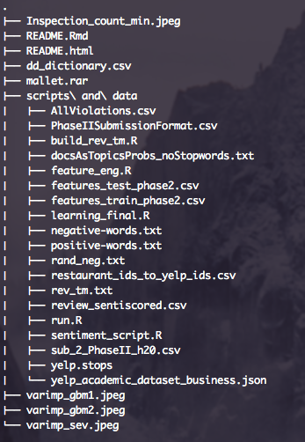
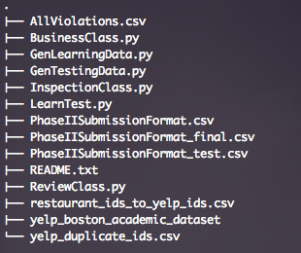
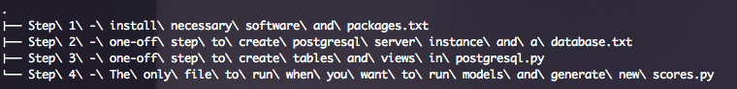
Notes:
From competition

Slide 13
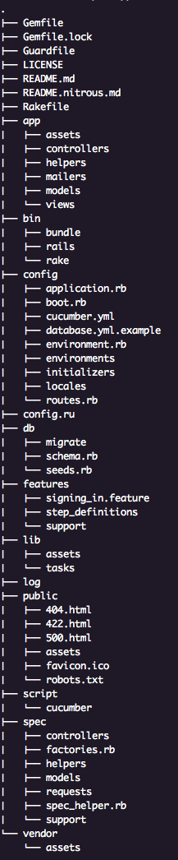
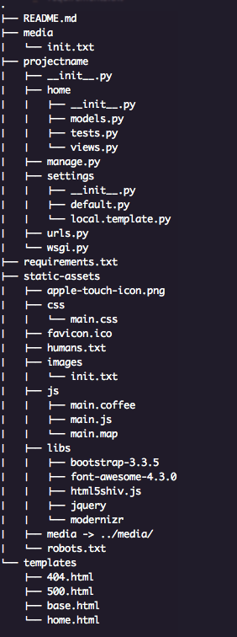
Ruby on Rails
Application
Django
Application

Slide 14
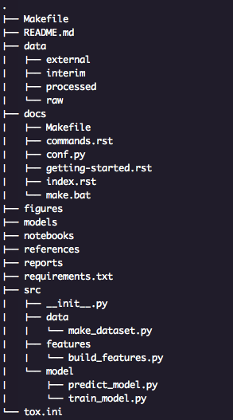
Notes:
Released soon as cookiecutter template!

Slide 15
DATA SCIENCE COOKIECUTTER (SOON!)

Slide 16
3
Edit-run-repeat:
Stopping the cycle of pain

Slide 19
Autoreload, pdb, debug
Q, modules
Assert, Unittest
Engarde, numpy.testing

Slide 20
4
Next-level code inspection

Slide 21
Notes:
- unexplored map for coverage

Slide 23

Notes:
- %timeit and %prun for profiling

Slide 25

Notes:
Linting + IDEs

Slide 27
COVERAGe.py
%prun
PYCHARM
FLAKE8 linting for sublime

Slide 28
Not Covered
Version Control | git
Code review | git branch + pull requests
Branching strategy | GitHub Flow
Issue tracking | GitHub Issues + waffle.io
Automating workflows | Make
Documentation Generator | Sphinx
Docstrings | Sphinx ReST
Style guide | flake8
Notebook diffing | nbconvert to .py on save
Configuration isolation | config.py
Continuous Integration | Codeship

Slide 29
Questions?
DRIVENDATA
@drivendataorg / @pjbull
peter@drivendata.org
Notes:
- linting
- unit testing
- watch window
- on save hooks

